Slide 1
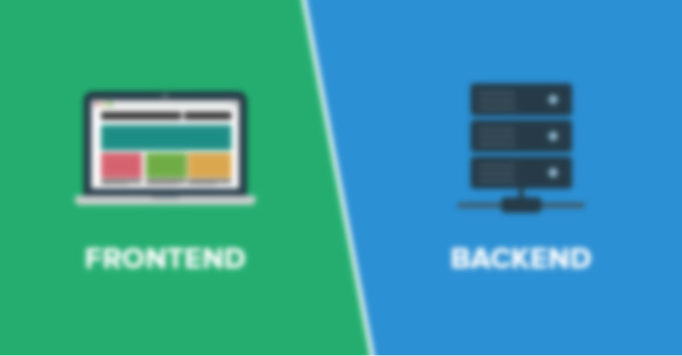
Developing Back End’s
Wladymir Brborich

Slide 2
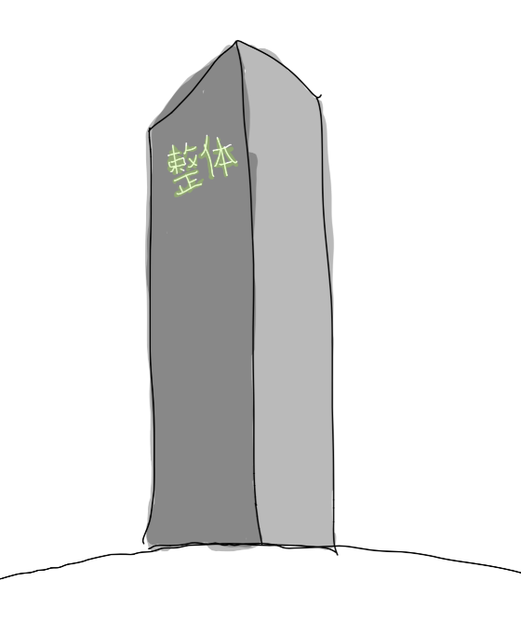

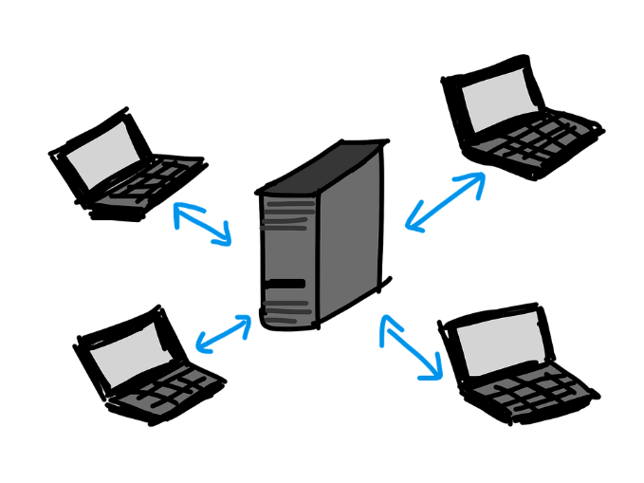

A bit of history
Monoliths
Client-Server
N-Tier
Microservices*

Slide 3
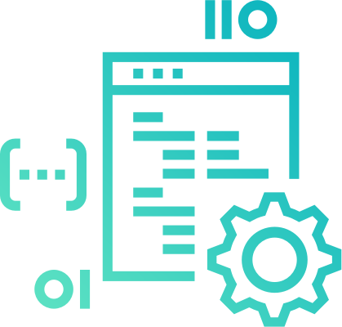
Back? End?
Usually we call Back End to the “Server-Side” code
Calculations, Data manipulation, DB Interactions, “Heavy Lifting”
If you like problem solving and algorithms this is your area

Slide 4



Basic things you need to know
Understand how HTTP works
Understand JSON
Understand REST

Slide 5
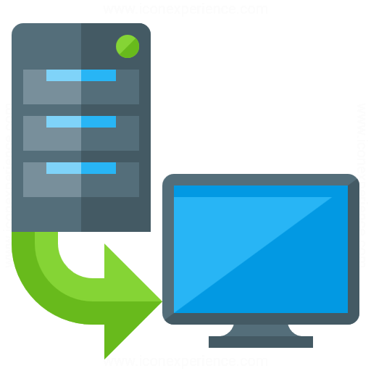

HTTP
Hypertext Transfer Protocol
Application layer protocol
Designed to communicate web browsers and web servers
Stateless
Source: https://developer.mozilla.org/en-US/docs/Web/HTTP

Slide 6
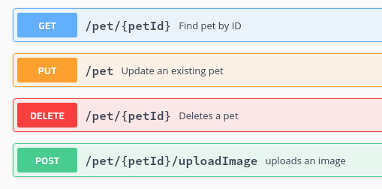
HTTP Request Methods
GET and POST are the most common
PUT and DELETE not so much
This methods allow you to indicate what action you want to be performed in a given resource
Source: https://developer.mozilla.org/en-US/docs/Web/HTTP/Methods

Slide 7

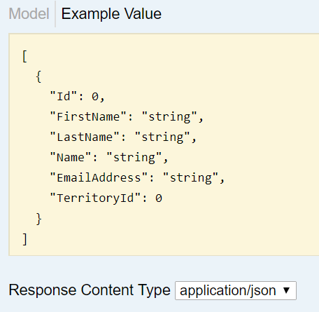
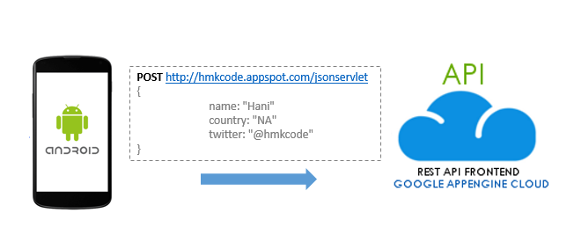
JSON
Short for JavaScript Object Notation
Lightweight text format to serialize objects.
Not always the solution, but good enough for us.

Slide 8


REST
Representational state transfer
Architectural principles
Scalability claims
Interface between systems that runs on HTTP

